Slide 1

Social Investment Agency
Your voice, your data, your say on social wellbeing
Presentation 4
Notes:
General comments:
Condense content under each topic – especially questions – avoid repetitive questions and try to clump into similar themes under each topic in logical flow. Frame questions in terms of soliciting feedback that can be compared across sectors/synthesised logically and efficiently – for concrete answers rather than broad generalisations
Include examples where possible – recognising difference between sectors attending workshops assemble a “pool” of examples that could be used for different circumstances
Differentiate between “information” that is collected and “data” that is derived from information – be clear in the terminology throughout (a short glossary in context document might also help with this)
Confirmed “service user” preferable to “service user” as a term
Comment about “Still looking for the guidelines ... “ i.e. trying to figure out which part of the document had the “use this, if your purpose is that” [complicated to address in engagement]
Make it clear what’s not in scope: “this slide deck needs sufficient context too, even if there’s a separate context doc.” Good point!
Strengthen the perspective on a person’s right to privacy: context doc plays that role but look for opportunities here too
Concepts of relationships among organisations in sector and partnership: see Implementation slide
Find somewhere to acknowledge the impact of data collection on the relationship between front line worker and service user (noted much later in meeting an additional suggestion to include engagement with front line staff, already being considered)

Slide 2


What we will talk about
The Social Investment Agency
Data Protection and Use Policy
Investing for social wellbeing approach
  Background and context
  Timeline
Notes:
Finally, reflections on what the change in Govt might mean for SI

Slide 3
The Social Investment Agency
Investing in what works for better lives
We are a catalyst for change. We apply our skills to technology and data, to create evidence about what works for whom, to improve decision-making and create positive change.
Notes:
Preference for “what we’ve learned” rather than “heard”
Guidelines and tools to be merged
Preference to replace “legal framework” with something more like “complex laws, policies and procedures” (more plain language)
Implementation: Build in questions around ways organisations within the sector can work together better: how to support strong relationships and partnerships within the sector for better outcomes

Slide 4
Some things we are doing
Data Protection & Use Policy
This policy will inform, clarify and guide the use of data for social service delivery, including its use for social investment purposes.
Government’s investing for social wellbeing approach
A discussion with all New Zealanders on the Government’s investing for social wellbeing approach, inviting feedback and opinions for further development.
Data Exchange (DX)
A “smart pipe” that enables the safe, secure and easy sharing of data, with a view to improving service effectiveness and outcomes across the social sector. Organisations using the DX retain full control of the what, when and who of their data sharing.
Measurement & Insights
We are developing a wellbeing measurement system to support decision makers across the social sector to collectively achieve better outcomes for New Zealanders. We’re also developing population analysis tools for providers so they can better understand their communities and tailor their services.
Commissioning & Partnerships
They key to commissioning is collaboration between social sector agencies and providers – those best placed to determine need, and design and provide services. At the simplest level, this involves co-designing services with providers. At a more comprehensive level, it involves enduring partnerships between agencies and providers, by supporting providers to take responsibility for making decisions on what communities and families need.
Notes:
General comments:
Condense content under each topic – especially questions – avoid repetitive questions and try to clump into similar themes under each topic in logical flow. Frame questions in terms of soliciting feedback that can be compared across sectors/synthesised logically and efficiently – for concrete answers rather than broad generalisations
Include examples where possible – recognising difference between sectors attending workshops assemble a “pool” of examples that could be used for different circumstances
Differentiate between “information” that is collected and “data” that is derived from information – be clear in the terminology throughout (a short glossary in context document might also help with this)
Confirmed “service user” preferable to “service user” as a term
Comment about “Still looking for the guidelines ... “ i.e. trying to figure out which part of the document had the “use this, if your purpose is that” [complicated to address in engagement]
Make it clear what’s not in scope: “this slide deck needs sufficient context too, even if there’s a separate context doc.” Good point!
Strengthen the perspective on a person’s right to privacy: context doc plays that role but look for opportunities here too
Concepts of relationships among organisations in sector and partnership: see Implementation slide
Find somewhere to acknowledge the impact of data collection on the relationship between front line worker and service user (noted much later in meeting an additional suggestion to include engagement with front line staff, already being considered)

Slide 5
The Data Protection and Use Policy
SIA has been asked to develop a policy, to guide the social sector in relation to individuals personal information.
In practical terms, the policy is a collection of guidance for social sector organisations on what to consider when collecting, storing, sharing and using personal information.
The scope of the policy spans the breadth of the social sector including justice, health, education, welfare, children/child safety, and research functions.
It will provide flexibility for all social sector organisations to ensure their unique or specialised delivery models function consistently and effectively with the policy.
Notes:
Preference for “what we’ve learned” rather than “heard”
Guidelines and tools to be merged
Preference to replace “legal framework” with something more like “complex laws, policies and procedures” (more plain language)
Implementation: Build in questions around ways organisations within the sector can work together better: how to support strong relationships and partnerships within the sector for better outcomes

Slide 6
The investing for social wellbeing approach
Government wants to develop a clear understanding of what investing for social wellbeing means that the social system agrees with and will support.
The SIA have been tasked with engaging social sector stakeholders to get their input, as we support the social system provide services for the public.
We currently talk about investing for social wellbeing as being about:
      investing in people for the betterment of all and working with them, their families and communities in partnership with government and NGOs, to support them to realise their full potential and improve their wellbeing.
We will be incorporating this discussion into our engagement on the policy.
Notes:
General comments:
Condense content under each topic – especially questions – avoid repetitive questions and try to clump into similar themes under each topic in logical flow. Frame questions in terms of soliciting feedback that can be compared across sectors/synthesised logically and efficiently – for concrete answers rather than broad generalisations
Include examples where possible – recognising difference between sectors attending workshops assemble a “pool” of examples that could be used for different circumstances
Differentiate between “information” that is collected and “data” that is derived from information – be clear in the terminology throughout (a short glossary in context document might also help with this)
Confirmed “service user” preferable to “service user” as a term
Comment about “Still looking for the guidelines ... “ i.e. trying to figure out which part of the document had the “use this, if your purpose is that” [complicated to address in engagement]
Make it clear what’s not in scope: “this slide deck needs sufficient context too, even if there’s a separate context doc.” Good point!
Strengthen the perspective on a person’s right to privacy: context doc plays that role but look for opportunities here too
Concepts of relationships among organisations in sector and partnership: see Implementation slide
Find somewhere to acknowledge the impact of data collection on the relationship between front line worker and service user (noted much later in meeting an additional suggestion to include engagement with front line staff, already being considered)

Slide 7





Engagement topics - policy
ONLY WHAT IS NEEDED
SHARING VALUE
SAFETY & CAPACITY
TRANSPARENCY &
COMMUNICATION
OPT IN/OPT OUT &
CONSENT

Slide 8
Engagement themes - investing for social wellbeing
Putting people at the centre
Needs of people are at the heart of the approach. It takes into account that people lead diverse lives with different needs, It is inclusive, and treats people with dignity and respect.
Makes better use of a wide range of data
This approach takes into account that people are more than just numbers. While we still need to use data and evaluation results, we also need to listen to people’s experiences and frontline knowledge to understand what interventions work. We will also create new evidence through testing and trialling new ideas.
Engaging and working in strong partnerships and building trust
We will actively work to grow public confidence through engaging and working in strong partnerships with a wide range of stakeholders. This will enable us think holistically to solve complex and cross-cutting issues like child poverty, mental health and housing. We will work to build trust in the solutions that we develop, including rebuilding people’s confidence in the ethical use of data.
Clear goals and robust measurement
The approach will require government agencies and key stakeholders to work towards the same goals and outcomes, including measuring the impact of what we do and progress towards goals. We will provide clear direction and guidance for government agencies to enable them to make well considered, fiscally responsible, evidence based choices about where to invest to improve wellbeing and enable them to be prepared to invest now for future benefits.

Slide 9
Developing the policy
Who
Service users, iwi, Pacific peoples, NGOs, Govt agencies, Peak Bodies, disabled people and the general public.
When
The first phase of regional engagement will take place from May until August 2018. A secondary consultation process will take place late 2018 and early 2019 once the policy has been drafted.
Where
This is a NZ-wide engagement process. There will be over 100 engagement sessions across all stakeholders.
How
We will conduct direct engagement sessions and offer the opportunity for people to provide feedback online. Both processes will allow for anonymised feedback.
Notes:
Preference for “what we’ve learned” rather than “heard”
Guidelines and tools to be merged
Preference to replace “legal framework” with something more like “complex laws, policies and procedures” (more plain language)
Implementation: Build in questions around ways organisations within the sector can work together better: how to support strong relationships and partnerships within the sector for better outcomes

Slide 10
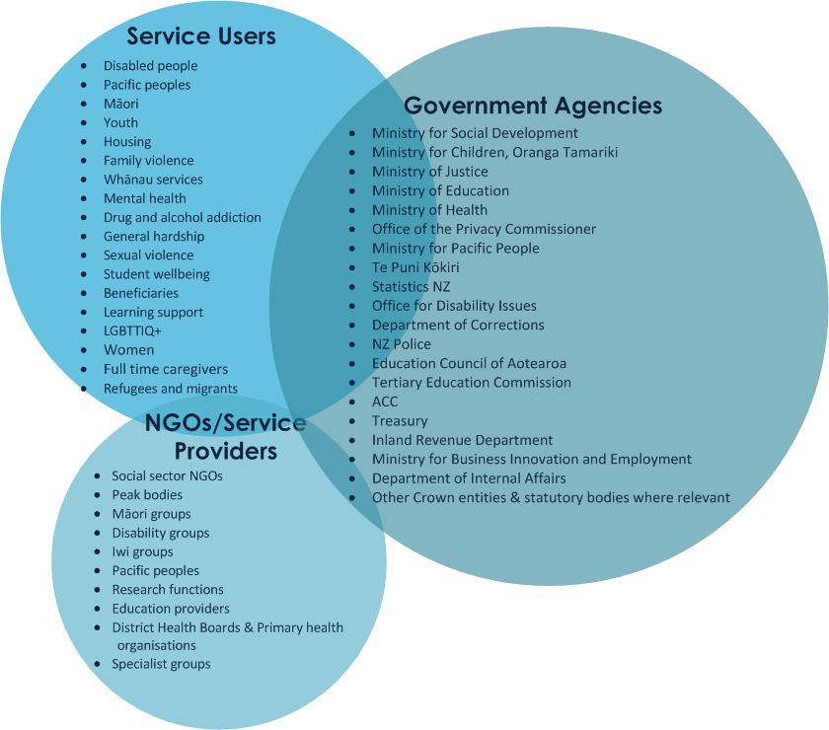
Who we’re talking to
Notes:
Question around whether “use” is the right term: key words are “only what you need”
OPC felt last statement in descriptor should be the first (but that isn’t actually the key point of this slide)
Fourth bullet of what we’ve learned so far should be a statement not a question
Answer to first question can be expected to differ depending on who is answering it
Here in particular examples would be helpful
“Focus on the crux of it: which is [what sort of information should you think about using for what sort of purpose]”
“Think about making clearer ‘what are the circumstances under which we should’ ... [in relation to collecting/using/sharing personal information]”
Be careful about what the word “you” means in differing contexts, be clearer where there’s a risk of miscommunication
Consider making it clearer that purpose drives what you need / use / collect, so potential to make this logic clearer in the arrangement of the language.

Slide 11
Guiding the work
The project’s Working Group ensures that the policy will be valued and used once completed. They meet monthly, providing advice and assistance on:
Ensuring that appropriate consultation occurs
How to engage effectively with NGOs, Iwi, Pacific people and service users
Promoting consistent and open communication as the work progresses
The Working Group consists of representatives from Social Sector agencies, NGOs, Peak Bodies, Iwi, Pacific Peoples, disabilities advocate and a client representative.
Notes:
General comments:
Condense content under each topic – especially questions – avoid repetitive questions and try to clump into similar themes under each topic in logical flow. Frame questions in terms of soliciting feedback that can be compared across sectors/synthesised logically and efficiently – for concrete answers rather than broad generalisations
Include examples where possible – recognising difference between sectors attending workshops assemble a “pool” of examples that could be used for different circumstances
Differentiate between “information” that is collected and “data” that is derived from information – be clear in the terminology throughout (a short glossary in context document might also help with this)
Confirmed “service user” preferable to “service user” as a term
Comment about “Still looking for the guidelines ... “ i.e. trying to figure out which part of the document had the “use this, if your purpose is that” [complicated to address in engagement]
Make it clear what’s not in scope: “this slide deck needs sufficient context too, even if there’s a separate context doc.” Good point!
Strengthen the perspective on a person’s right to privacy: context doc plays that role but look for opportunities here too
Concepts of relationships among organisations in sector and partnership: see Implementation slide
Find somewhere to acknowledge the impact of data collection on the relationship between front line worker and service user (noted much later in meeting an additional suggestion to include engagement with front line staff, already being considered)

Slide 12
What’s Next?
The SIA will advise your agency of the planned times and locations for those interested in being involved in the direct engagement workshops.
In our engagement with national agency staff, we are keen that in addition to privacy and policy managers from your organisation, people with practical operational experience and data management responsibilities participate in the workshops.
For regional agency workshops, we hope that those attending come well prepared to bring their experiences and organisational viewpoints to the discussion.
We will be seeking your assistance in raising awareness among your agency staff and contractors of the opportunity to participate online as well.
Please feel free to contact the team directly via yoursay@sia.govt.nz.
Notes:
General comments:
Condense content under each topic – especially questions – avoid repetitive questions and try to clump into similar themes under each topic in logical flow. Frame questions in terms of soliciting feedback that can be compared across sectors/synthesised logically and efficiently – for concrete answers rather than broad generalisations
Include examples where possible – recognising difference between sectors attending workshops assemble a “pool” of examples that could be used for different circumstances
Differentiate between “information” that is collected and “data” that is derived from information – be clear in the terminology throughout (a short glossary in context document might also help with this)
Confirmed “service user” preferable to “service user” as a term
Comment about “Still looking for the guidelines ... “ i.e. trying to figure out which part of the document had the “use this, if your purpose is that” [complicated to address in engagement]
Make it clear what’s not in scope: “this slide deck needs sufficient context too, even if there’s a separate context doc.” Good point!
Strengthen the perspective on a person’s right to privacy: context doc plays that role but look for opportunities here too
Concepts of relationships among organisations in sector and partnership: see Implementation slide
Find somewhere to acknowledge the impact of data collection on the relationship between front line worker and service user (noted much later in meeting an additional suggestion to include engagement with front line staff, already being considered)

